Slide 1

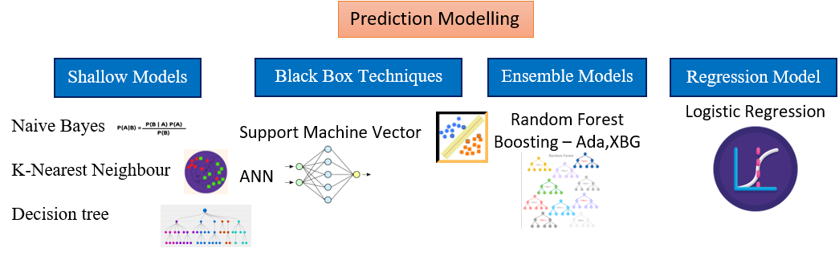

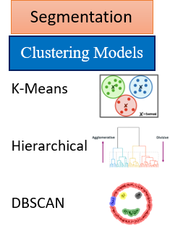






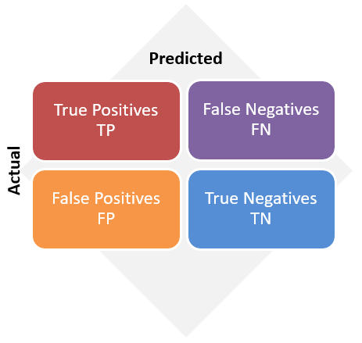




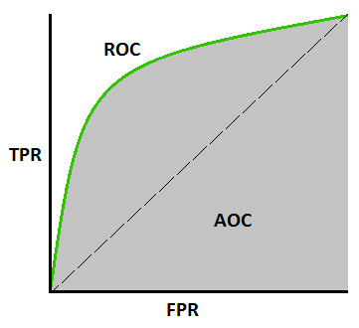
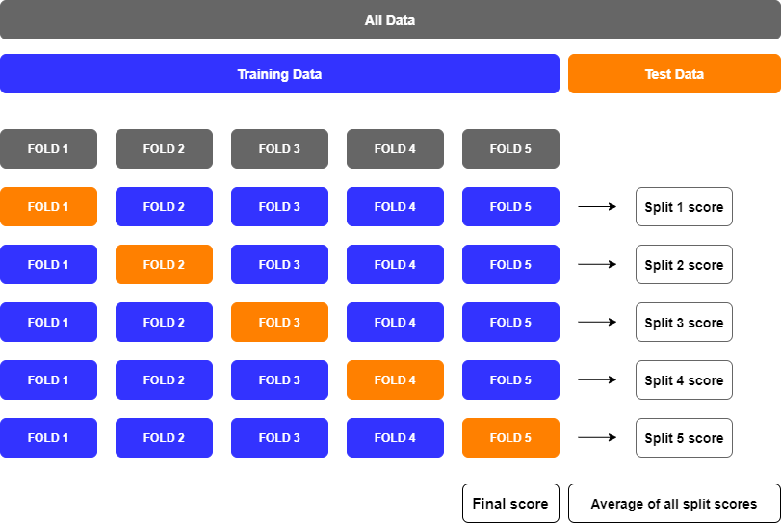
Data Pre-Processing
Dimension Reduction
Machine Learning
Data Cleansing
Principal Component Analysis
Dataframe with
26 Principal Components
EDA/Description Statistics
Dataframe with 36 features
Feature Engineering
MySQL Connector API
Packages
Model Accuracy
Hyper-Parameter Tuning
Confusion Matrix
Accuracy, Sensitivity, Specificity, Precision, Recall,
F1 score,
F-Beta score,
ROC and AUC
Grid search CV
Random search CV
Stratified CV
Client Server
Model Deployment
Model Evaluation

